Slide 1
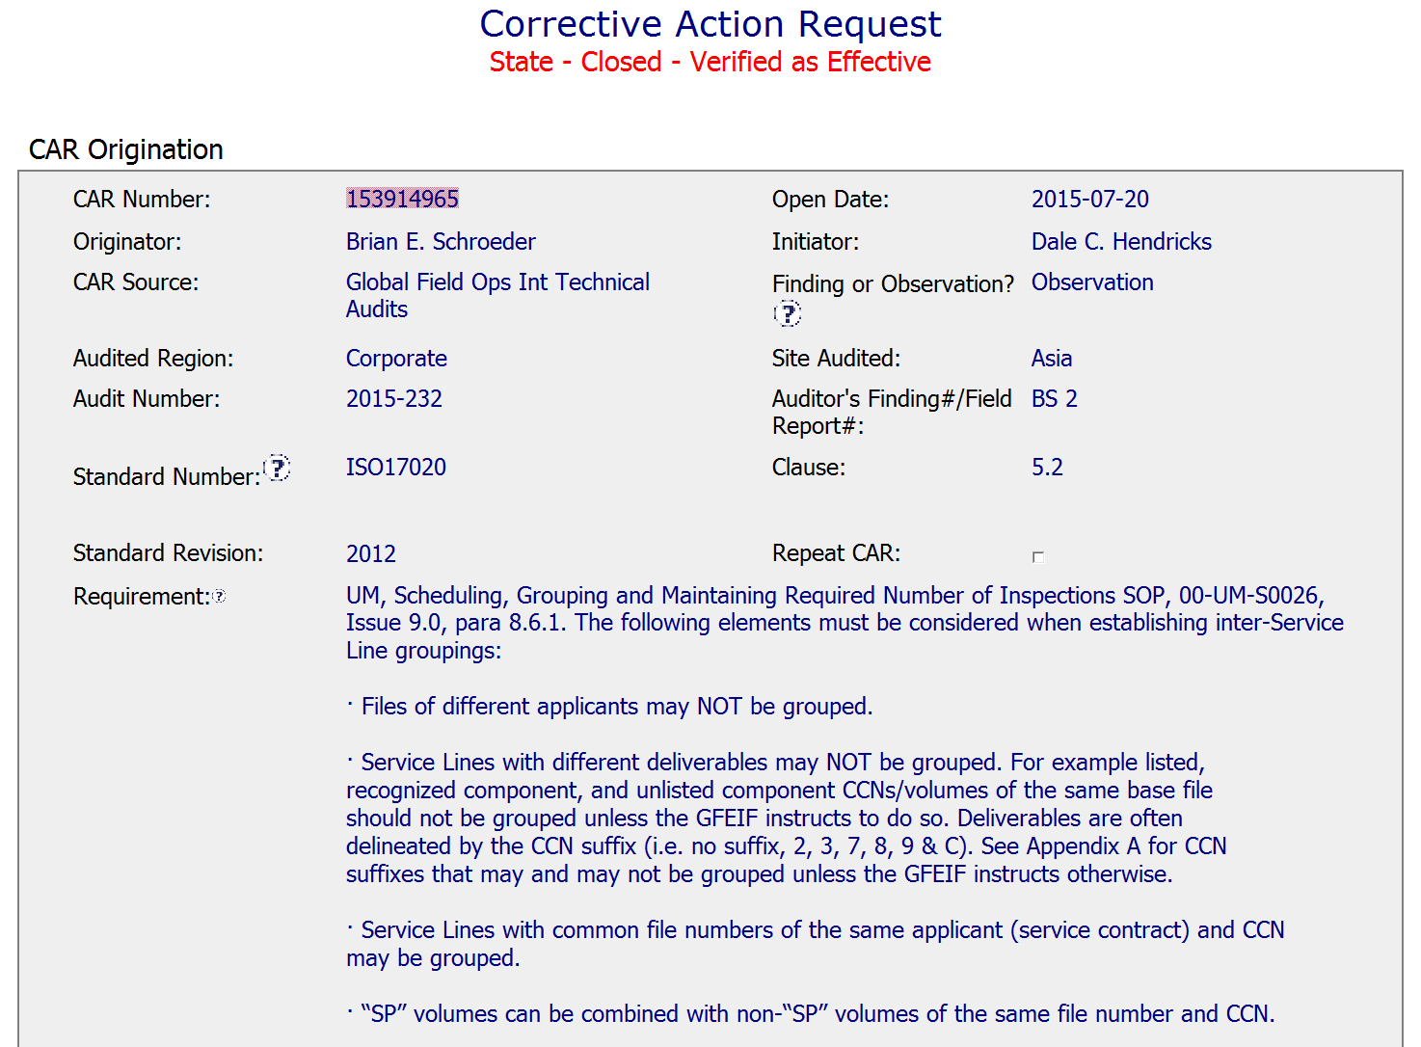
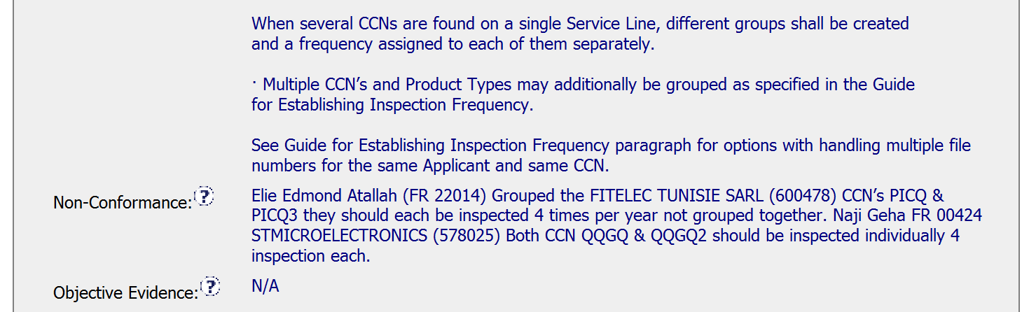
CAR 153914965
CLEAR
Statement of requirement and Non-conformance

Slide 2
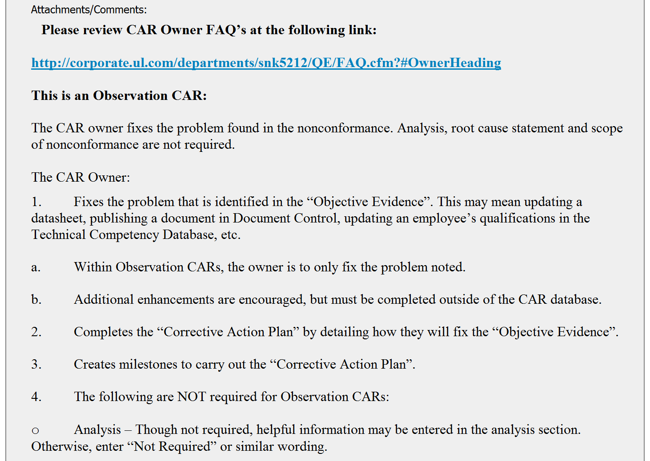
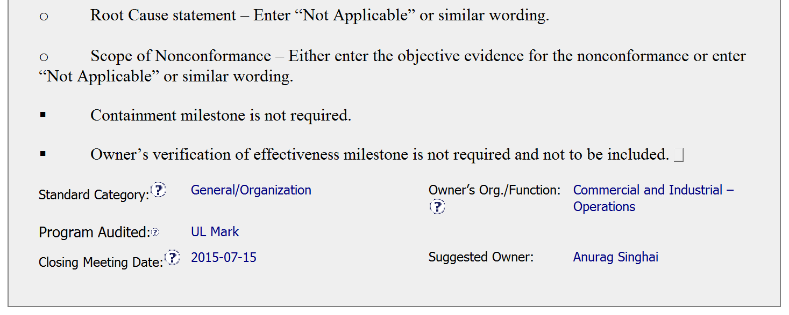
CAR 153914965
EXCELLENT
CAR Initiator has provided steps to CAR Owner on ‘HOW’ to work on the observation CAR

Slide 3
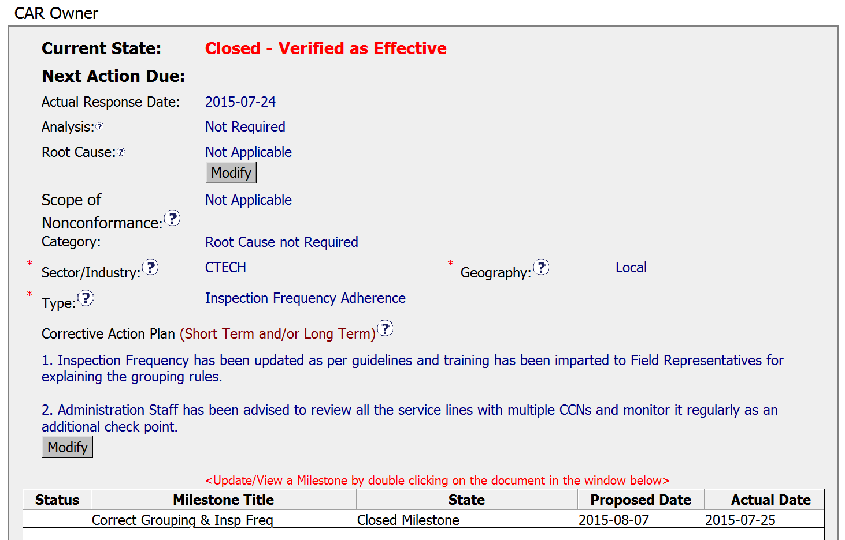
CAR 153914965
COMPLIANCE
CAR Owner has used the steps provided by CAR Initiator
COMPLIANCE
CAR Champion has selected the appropriate fields for Observation CAR
CLEAR
Corrective action addresses fixing the non-conformance and beyond

Slide 4
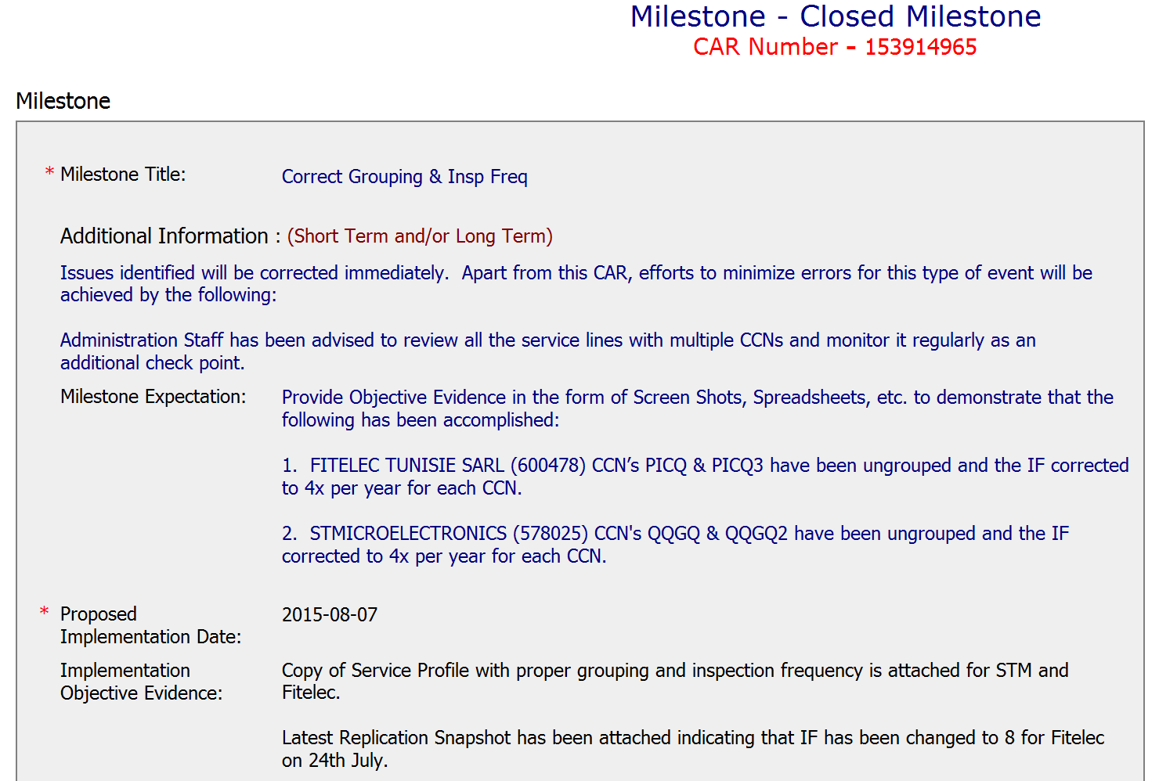
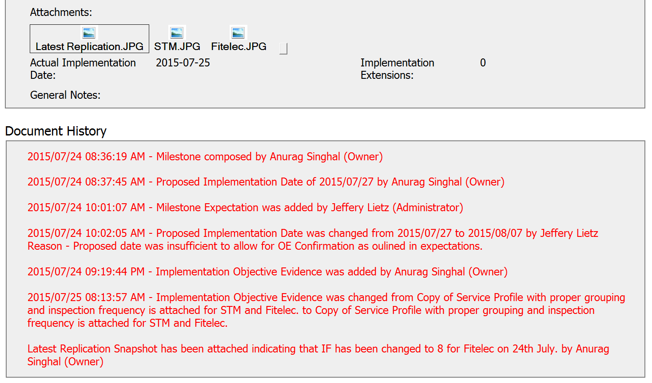
CAR 153914965
COMPLIANCE
Corrective action is completed with evidence
COMPLIANCE
CAR Champion has communicated the expectations clearly to the CAR Owner

Slide 5
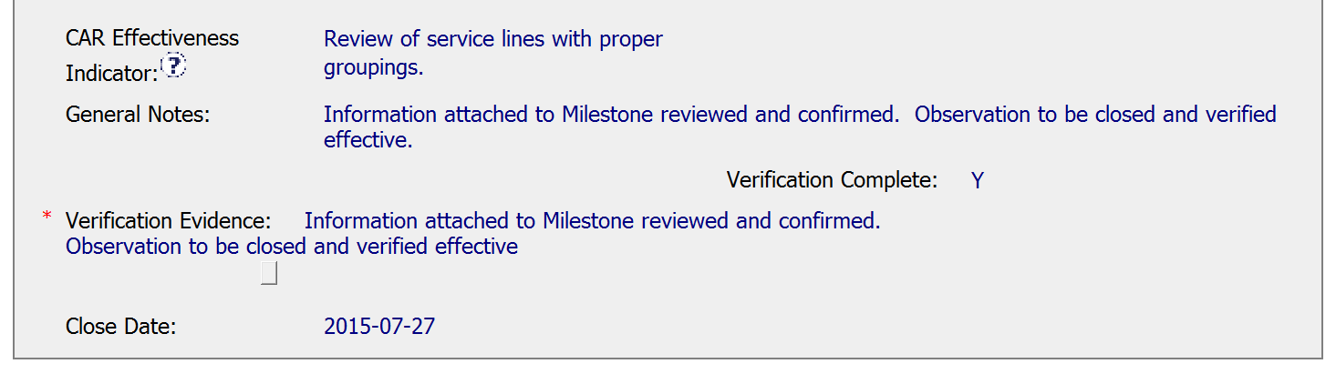
CAR 153914965
CLEAR
CAR Effectiveness Indicator
CLEAR
Verification Evidence

Slide 6
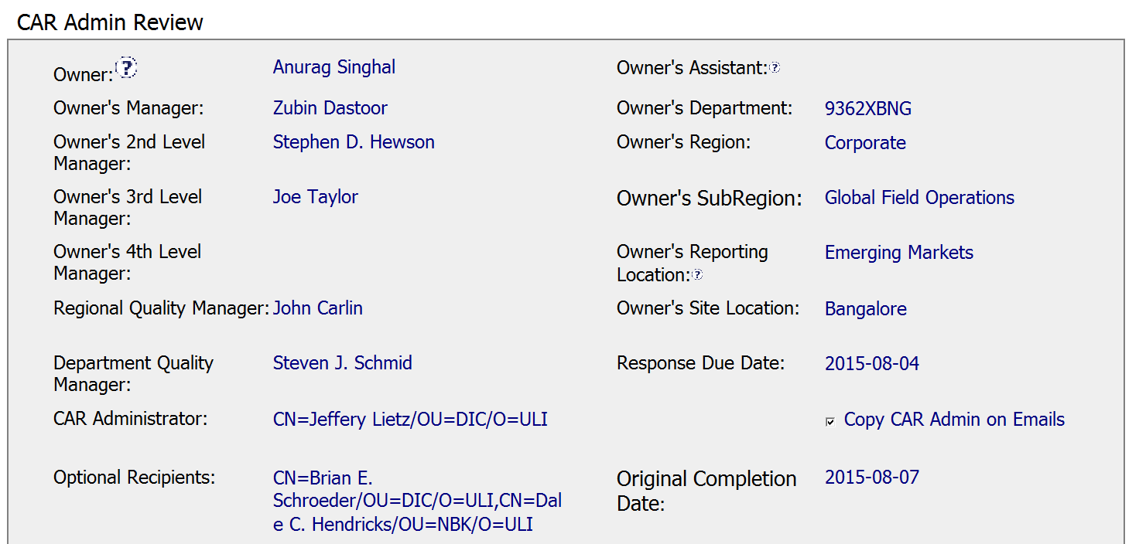
CAR 153914965
COMPLIANCEAll fields are filled as per guidelines

Slide 7
CAR 153914965 – CBS Check
CBS Requirements | Excellent | Moderate | Need Improve | N/A
(C) Extensions are within requirement (<30 days, 3 or less) | √
(T) Most appropriate ‘category’, ‘type’, ‘geography’ are selected | √
(P) Facilitates the handling of disputed CARs |  |  |  | √
(T) Acts on CARs within required timeframe | √
(C) Analysis shows clear path to root cause and scope; stakeholders identified |  |  |  | √
(C) Root cause statement is succinct, reasonable, complete (Shows ‘N/A’ for observations) | √
(C) Corrective actions fix the objective evidence and other problems found; address entire root cause and scope. For observations, they do not go beyond fixing the objective evidence | √
(C) Milestones address containment & owner’s verification; completed per milestone expectations |  |  |  | √
(P) Verification per requirements | √
(L) Referenced communications are attached as needed | √
(C L) Evidence of communication for overdue/escalated CARs and other pertinent concerns |  |  |  | √
(P) Trains other CAR Champions |  |  |  | √

